Slide 1


T.Y. Minor Project Presentation
AI-Driven Vulnerability Index Mapping for Districts in Maharashtra to El Niño Droughts Using Socio-Economic and Climatic PCA
Guide: Prof. Pankaj Deshmukh
Group No: 12
Mr. Mewada Tanishq (34-A)
Mr. Patel Saad (47-A)
Ms. Patki Peeyusha (48-A)
Department of Artificial Intelligence & Data Science, K. J. Somaiya Institute of Technology, Sion, Mumbai 400022
29/9/2026

Slide 2
Table of Contents
Sr. No.: | Topic
1. | Introduction
2. | Problem Statement & Proposed Solution
3. | Literature Survey
4. | Research Gaps
5. | Project Objectives
6. | Study Area & Datasets
7. | Selected Indicators
8. | Proposed Methodology
9. | Architecture Diagram
10. | Tools, Technologies and Resources
11. | PCA Results & Weights
29/9/2026

Slide 3
Table of Contents
Sr. No.: | Topic
12. | K-Means Classification
13. | Results: Vulnerability Maps
14. | Validation against Drought Declarations
15. | Validation Maps (2018 and 2023)
16. | Validation: 2026 Holdout
17. | Robustness & Sensitivity Analysis
18. | Limitations
19. | Future Scope
20. | Conclusion
21. | References
29/9/2026

Slide 4
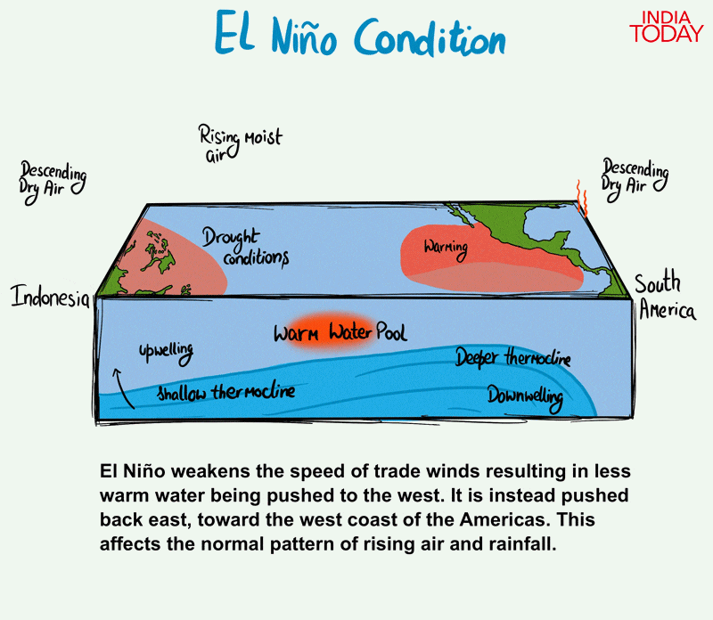
Introduction
The Global Phenomenon: El Niño is the unusual warming of the eastern Pacific Ocean that disrupts global atmospheric circulation.
The Impact on India: It weakens the monsoon, causing rainfall deficits and prolonged dry spells.
The Cascading Threat: Rainfall failure leads to crop failure, water scarcity and economic losses for farming communities.
True Vulnerability: It depends on both the climatic hazard and the socio-economic ability of people to cope.
Fig. 1: Illustration of the El Niño climatic mechanism
(Source:India Today)
29/9/2026

Slide 5
Problem Statement & Proposed Solution
Problem Statement
Existing drought indices often rely on subjective (AHP) weights and ignore socio-economic conditions at district level.
The district-specific impact of El Niño on Maharashtra's monsoon is rarely quantified.
An objective, data-driven and validated district vulnerability index is needed.
Proposed Solution
Six direction-aligned indicators of El Niño exposure, agricultural sensitivity and adaptive capacity for 34 districts.
PCA-derived weights combine them into a 0–100 index; K-Means (K = 3) gives Low, Medium and High groups.
Validation against drought declarations (2018, 2023, 2026 holdout), with maps and an interactive dashboard.
29/9/2026

Slide 6
Literature Survey
Sr. No. | Name of the Publication / Journal | Title of the Research Paper | Objective / Problem Discussed | Methodology | Dataset / Tools Used | Key Findings | Research Gap
1 | Hydrology Research (2026) | Sustainable drought resilience strategies in India | Review national drought frameworks | Literature Review | Policy & Climate data | 60% districts face water stress by 2030 | Conceptual only; lacks local quantitative metrics
2 | Environ Dev Sustain (2025) | Household vulnerability index to drought in Tamil Nadu | Assess rural household vulnerability | PCA | Surveys & Climate data | Ramanathapuram most vulnerable (0.86) | Limited to TN; no Maharashtra district mapping
3 | Global NEST Journal (2024) | Maharashtra River Basin flood-drought nexus | Analyze river basin water scarcity | Qualitative Case Study | Rainfall & Urban metrics | Found distinct regional scarcity patterns | Lacks quantitative indexing & ML clustering
4 | Water - MDPI (2023) | Drought vulnerability in NW Odisha via Fuzzy-AHP | Map basin-level drought risk | Fuzzy-AHP | GIS & Demographic data | Mapped 33% area as high drought risk | Subjective AHP weights; no unsupervised ML
Table 1: Literature Survey
29/9/2026

Slide 7
Literature Survey
Sr. No. | Name of the Publication / Journal | Title of the Research Paper | Objective / Problem Discussed | Methodology | Dataset / Tools Used | Key Findings | Research Gap
5 | Food Security (2023) | 2023-24 El Niño impact on India food security | Evaluate El Niño agricultural risk | Economic Modeling | ONI & Crop yield data | >70% districts suffer crop yield drops | Macro national scope; lacks district mapping
6 | Stoch Environ Res Risk Assess (2023) | Ensemble ML-based drought index in Odisha | Predict village drought vulnerability | Ensemble ML (M5P) | 53 Spatial indicators | High risk in 37.9% sampled regions | Complex model; no unsupervised clustering
7 | Gondwana Research (2022) | National drought vulnerability assessment | Map multidimensional drought risk | AHP & ML Regression | Climate & Census data | Socio-economic drought threatens food security | Manual weighing; no unsupervised ML grouping
8 | Arab J Geosci (2022) | Drought vulnerability in Vidarbha, Maharashtra | Assess regional drought intensity | SPI & SPEI Indices | Historic IMD rainfall | High drought severity in East Vidarbha | Index-based; stopped short of K-Means
Table 1: Literature Survey (Continued)
29/9/2026

Slide 8
Literature Survey
Sr. No. | Name of the Publication / Journal | Title of the Research Paper | Objective / Problem Discussed | Methodology | Dataset / Tools Used | Key Findings | Research Gap
9 | J King Saud Univ Sci (2022) | Drought vulnerability in Kangsabati Basin | Delineate basin hazard zones | GIS-based AHP | Remote Sensing & GIS | Mapped 21.1% area as high risk | Subjective AHP bias; lacks objective weighting
10 | Geomatics Nat Haz Risk (2021) | Spatial drought assessment via Fuzzy-AHP | Map state-wide vulnerability | Fuzzy-AHP | Weather & Census data | 33.94% area mapped as high risk | Expert-dependent weights; no ML clustering
11 | Natural Hazards (2021) | Regional drought vulnerability and risk using PCA and GMM | Objectively weight drought vulnerability indicators | PCA, GMM, equal weighting | Chungcheong Province, South Korea | PCA gave larger weights to agricultural and industrial factors | Not El Niño-specific; outside India
12 | PLOS One (2026) | Territorial composite vulnerability index, Cali | Guide public health action by territory | PCA weights from eigenvalue and absolute loading | 7 socio-economic indicators, Cali, Colombia | 3 components (67.9% variance); KMO 0.60 | Urban health focus; no climate hazard
Table 1: Literature Survey (Continued)
29/9/2026

Slide 9
Research Gaps
Existing review and national-scale studies are largely conceptual and do not provide district-level drought vulnerability mapping for Maharashtra.
AHP and Fuzzy-AHP based indices depend on subjective expert judgement to assign the weights of indicators.
Household-level and ensemble machine-learning indices focus on other states, use complex models and do not group districts through unsupervised learning.
SPI and SPEI hazard indices and qualitative basin studies capture the drought hazard but do not integrate socio-economic and agricultural factors.
Most existing studies do not measure El Niño-specific exposure and offer limited validation against observed drought declarations.
This project addresses these gaps through an objective, PCA-weighted district index for Maharashtra that is classified with K-Means and validated against drought declarations.
29/9/2026

Slide 10
Project Objectives
Combine district-level climatic and socio-economic records into a unified dataset for Maharashtra.
Apply PCA to objectively identify and weight the most critical vulnerability factors.
Implement K-Means clustering to categorize districts into Low, Medium, and High-risk drought zones.
Develop an interactive dashboard to map risk zones and enable proactive disaster management.
29/9/2026

Slide 11
Study Area & Datasets
Dataset | Source | Variables Used | Period
Gridded daily rainfall (0.25°) | IMD | District June–September rainfall (area-weighted) | 1950–2024
RONI / ONI | NOAA CPC | El Niño monsoon years (18), seasonal index values | 1950–2024
Primary Census Abstract | Census of India | Agricultural workers, literacy (age 7+) | 2011
Village Directory | Census of India | Irrigated and unirrigated area | 2011
Agriculture Census | Govt. of Maharashtra | Holdings below 2 ha | 2010-11
District boundaries | Survey of India | 36 district polygons | Current
Drought GRs | Govt. of Maharashtra | Declared talukas (validation only) | 2018, 2023, 2026
Table 2: Datasets Used
29/9/2026

Slide 12
Selected Indicators
Study area: 36 districts of Maharashtra; 34 in the index (Mumbai City and Mumbai Suburban excluded, no agricultural data).
Selection: six indicators chosen from 30 candidate variables; all standardised (z-scores) before PCA.
Sr. No. | Indicator | Dimension | Direction Alignment | Source
1 | El Niño rainfall sensitivity (% per °C RONI) | Exposure | × (−1): more negative slope = greater rainfall loss | IMD + NOAA RONI
2 | El Niño deficient-monsoon frequency | Exposure | × (+1) | IMD + NOAA RONI
3 | Agricultural-worker share of workers (%) | Sensitivity | × (+1) | Census 2011
4 | Rainfed share of cropped land (%) | Sensitivity | × (+1) | Census 2011 (Village Directory)
5 | Small-holding share (< 2 ha, %) | Sensitivity | × (+1) | Agriculture Census 2010-11
6 | Literacy rate, age 7+ (%) | Adaptive capacity | × (−1): higher literacy = lower vulnerability | Census 2011
Table 3: Selected Indicators
29/9/2026

Slide 13
Proposed Methodology
Data Sources: (IMD Rainfall, NOAA RONI, Census 2011, Agriculture Census)
Indicators & PCA: (6 Aligned Indicators, PCA-derived Weights)
Validation & Output: (Drought GRs, Maps, Streamlit Dashboard)
Preprocessing: (Area-weighting, 1971–2020 Baseline, Palghar Reconstruction)
Index & Classification: (0–100 Index, K-Means, K = 3)
29/9/2026

Slide 14
Architecture Diagram
IMD gridded rainfall
Standardisation
NOAA RONI / ONI
PCA & stability check
Census 2011
Data Sources
Modelling
PCA-derived weights
Agriculture Census
0–100 index
Survey of India maps
El Niño Drought Vulnerability Mapping
K-Means (K = 3)
District crosswalk
Drought GR validation
Area-weighted rainfall
Data Engineering
Evaluation & Output
Sensitivity analysis
El Niño years (RONI)
District maps
Indicator construction
Streamlit dashboard
Quality checks
Fig. 2: Architecture of the Vulnerability Mapping Pipeline
29/9/2026

Slide 15
Tools, Technologies and Resources
Hardware Requirements
Standard PC/Laptop: Minimum 8 GB RAM with an Intel i5 / Ryzen 5 processor; about 2 GB storage for IMD gridded rainfall files.
Software & Tech Stack
Programming Language: Python 3.12.
Data Processing & Modelling: Pandas, NumPy, SciPy, Scikit-learn (StandardScaler, PCA, K-Means), xarray / netCDF4.
Geospatial & Visualisation: GeoPandas, Shapely, Matplotlib; Streamlit for the interactive dashboard.
Quality & Version Control: pytest (69 automated tests), Git and GitHub.
Datasets (Maharashtra)
Climatic: IMD 0.25° gridded daily rainfall (1950–2024); NOAA CPC RONI and ONI.
Socio-economic & Agricultural: Census 2011 (Primary Census Abstract, Village Directory); Agriculture Census 2010-11.
Spatial & Validation: Survey of India district boundaries; Government of Maharashtra drought GRs (2018, 2023, 2026).
29/9/2026

Slide 16
PCA Results & Weights
Component | Eigenvalue | Explained Variance (%) | Cumulative (%)
PC1 | 2.056 | 34.3 | 34.3
PC2 | 1.246 | 20.8 | 55.0
PC3 | 1.165 | 19.4 | 74.5
PC4 | 0.663 | 11.1 | 85.5
PC5 | 0.616 | 10.3 | 95.8
PC6 | 0.253 | 4.2 | 100.0
Indicator | Dimension | Weight
El Niño rainfall sensitivity | Exposure | 0.168
El Niño deficient frequency | Exposure | 0.151
Agricultural-worker share | Sensitivity | 0.183
Rainfed share of cropped land | Sensitivity | 0.173
Small-holding share | Sensitivity | 0.161
Literacy (aligned) | Adaptive capacity | 0.164
Total |  | 1.000
Table 4: PCA Eigenvalues and Explained Variance
Table 5: PCA-Derived Indicator Weights
First three components (eigenvalue > 1, 74.5% variance) are retained; each weight combines explained variance and absolute loadings, normalised to 1.
KMO = 0.40 indicates weak common-factor structure, so the weights are exploratory and close to equal.
29/9/2026

Slide 17
K-Means Classification
K-Means (K = 3, random_state = 2026, n_init = 20) applied only to the 0–100 index; clusters ordered by centroid (lowest → Low).
Silhouette score = 0.587; group boundaries at index values 29.8 and 64.1.
Group | Districts | Centroid | Index Range | Member Districts
High | 10 | 82.4 | 65.9–100.0 | Beed, Jalna, Latur, Dharashiv, Parbhani, Nanded, Nandurbar, Ahilyanagar, Solapur, Hingoli
Medium | 20 | 45.9 | 32.6–62.7 | Washim, Buldhana, Satara, Sangli, Dhule, Akola, Chh. Sambhajinagar, Palghar, Ratnagiri, Kolhapur, Jalgaon, Amravati, Yavatmal, Sindhudurg, Gadchiroli, Pune, Nashik, Raigad, Chandrapur, Wardha
Low | 4 | 13.8 | 0.0–25.6 | Bhandara, Gondia, Thane, Nagpur
Table 6: K-Means Vulnerability Groups
29/9/2026

Slide 18
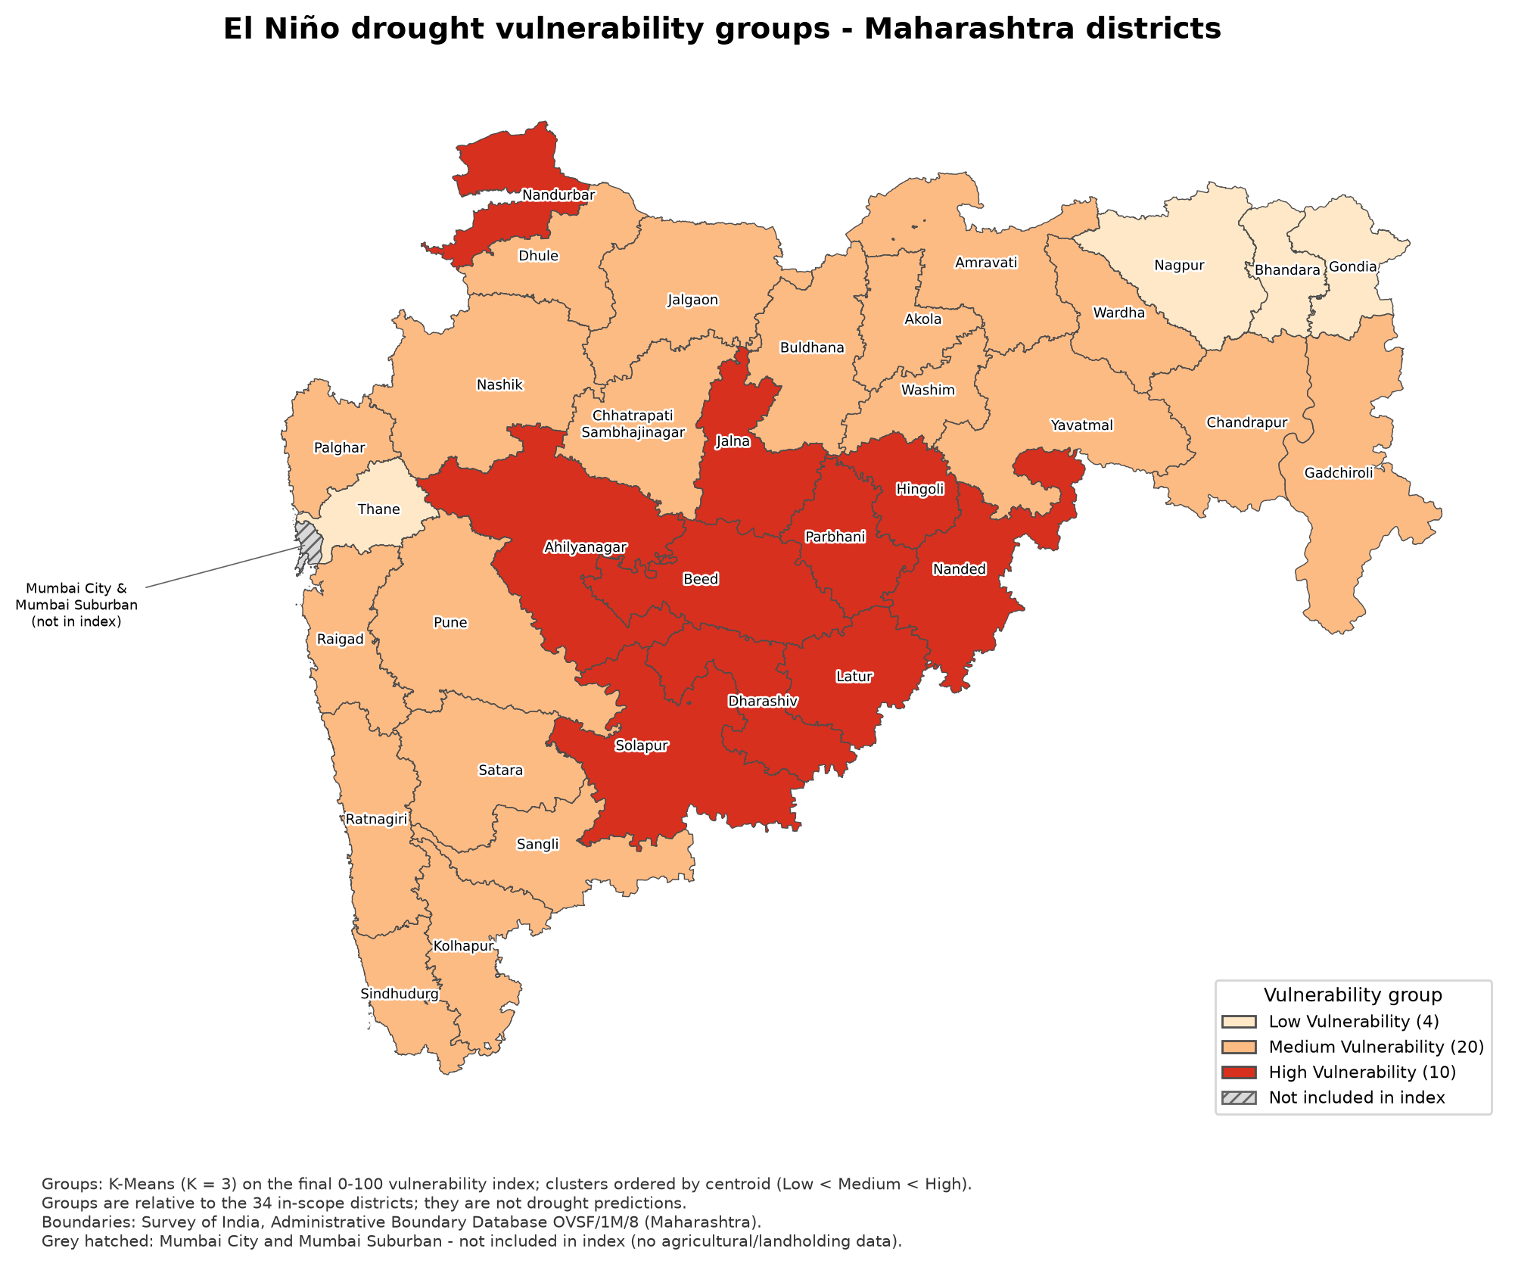
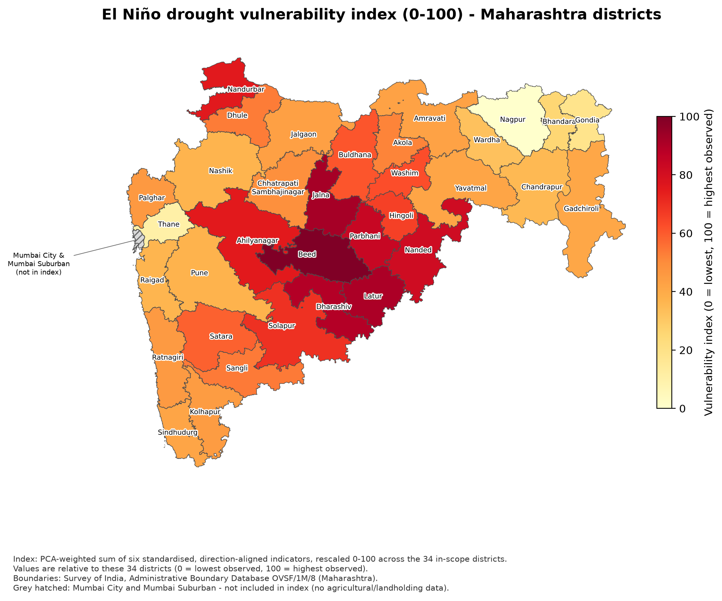
Results: Vulnerability Maps
Fig. 3: Low / Medium / High Vulnerability Groups
Fig. 4: Vulnerability Index (0–100)
29/9/2026

Slide 19
Validation against Drought Declarations
Year | Declaration (Govt. of Maharashtra GR) | Spearman ρ | p-value | Mean Declared Share (Low / Medium / High)
2018 | 151 talukas, final (severe + moderate) | 0.585 | 0.0003 | 0.05 / 0.39 / 0.66
2023 | 40 talukas, final (severe + moderate) | 0.450 | 0.008 | 0.00 / 0.10 / 0.20
2026 (holdout) | 265 talukas, Trigger-1 stage | 0.545 | 0.0009 | 0.39 / 0.70 / 0.99
Declared share = declared talukas ÷ Census 2011 talukas per district (n = 34); declarations were never used to build the index.
Higher index values were positively associated with larger declared shares in all three years, including the unseen 2026 holdout.
Limitations: the 1,021 separately listed revenue circles of 2023 are not included; the 2026 Trigger-1 stage has a ceiling effect.
Table 7: Validation Results
29/9/2026

Slide 20
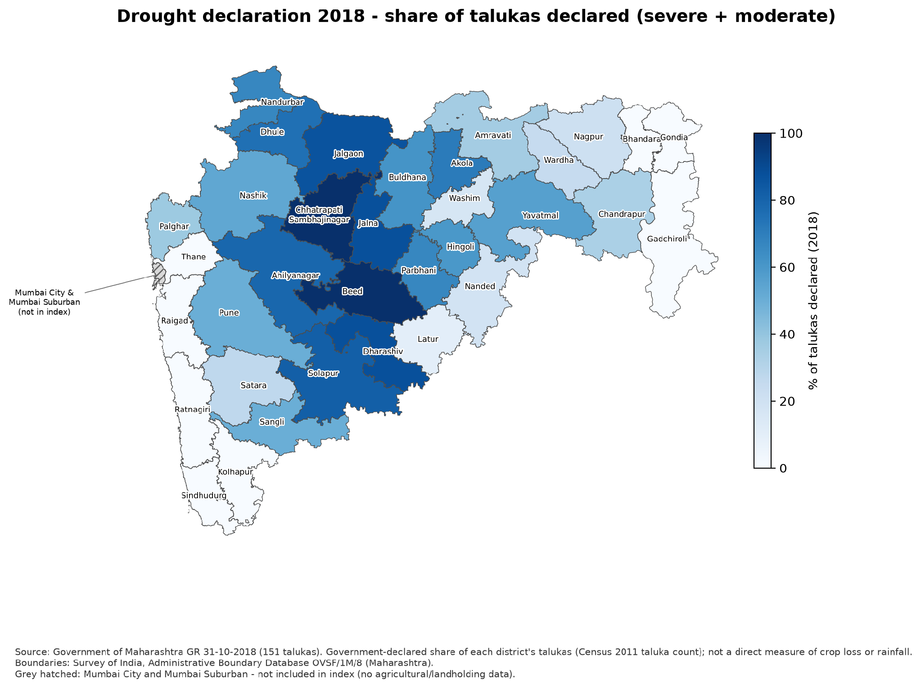
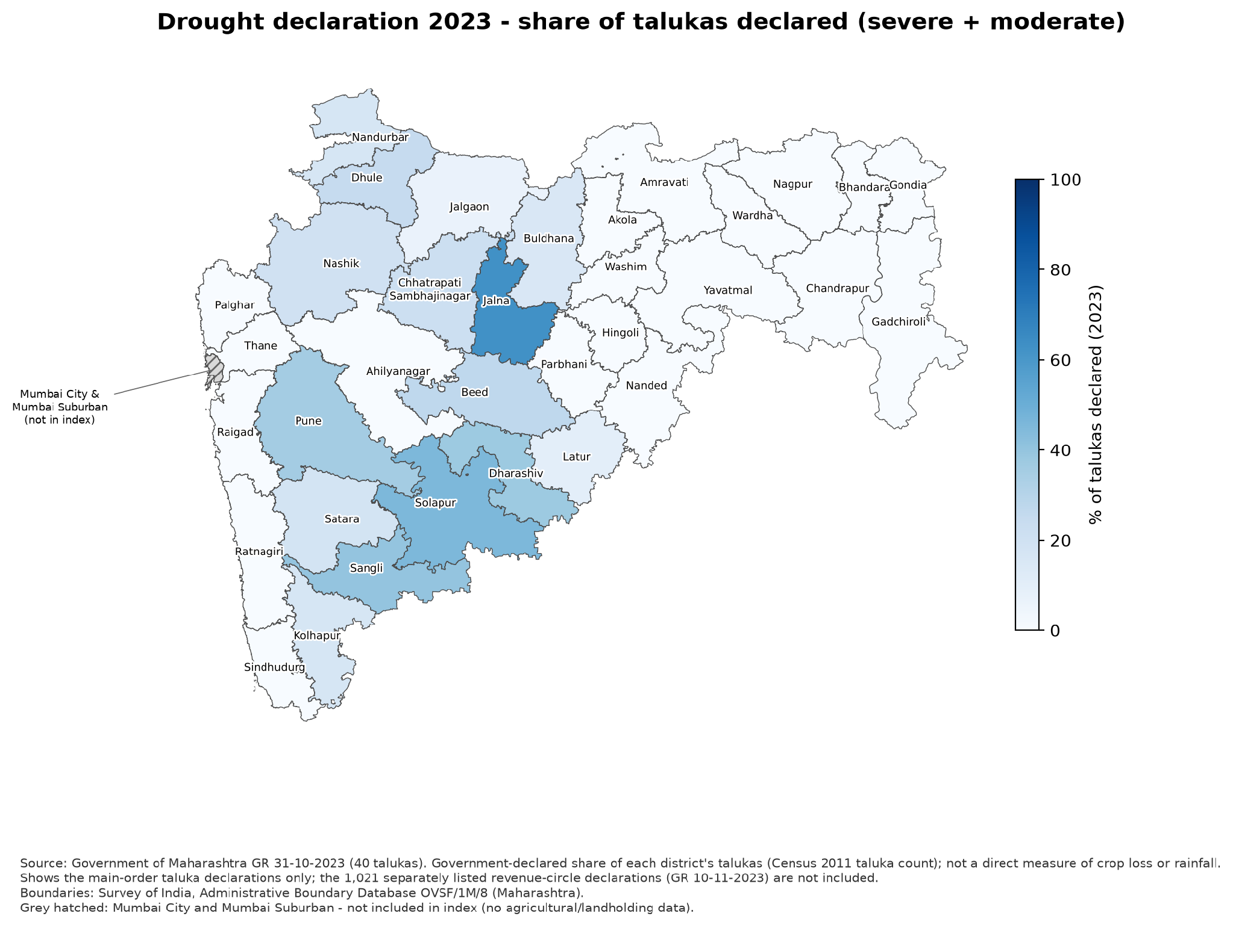
Validation Maps (2018 and 2023)
Fig. 5: Declared Taluka Share, 2018
Fig. 6: Declared Taluka Share, 2023
29/9/2026

Slide 21
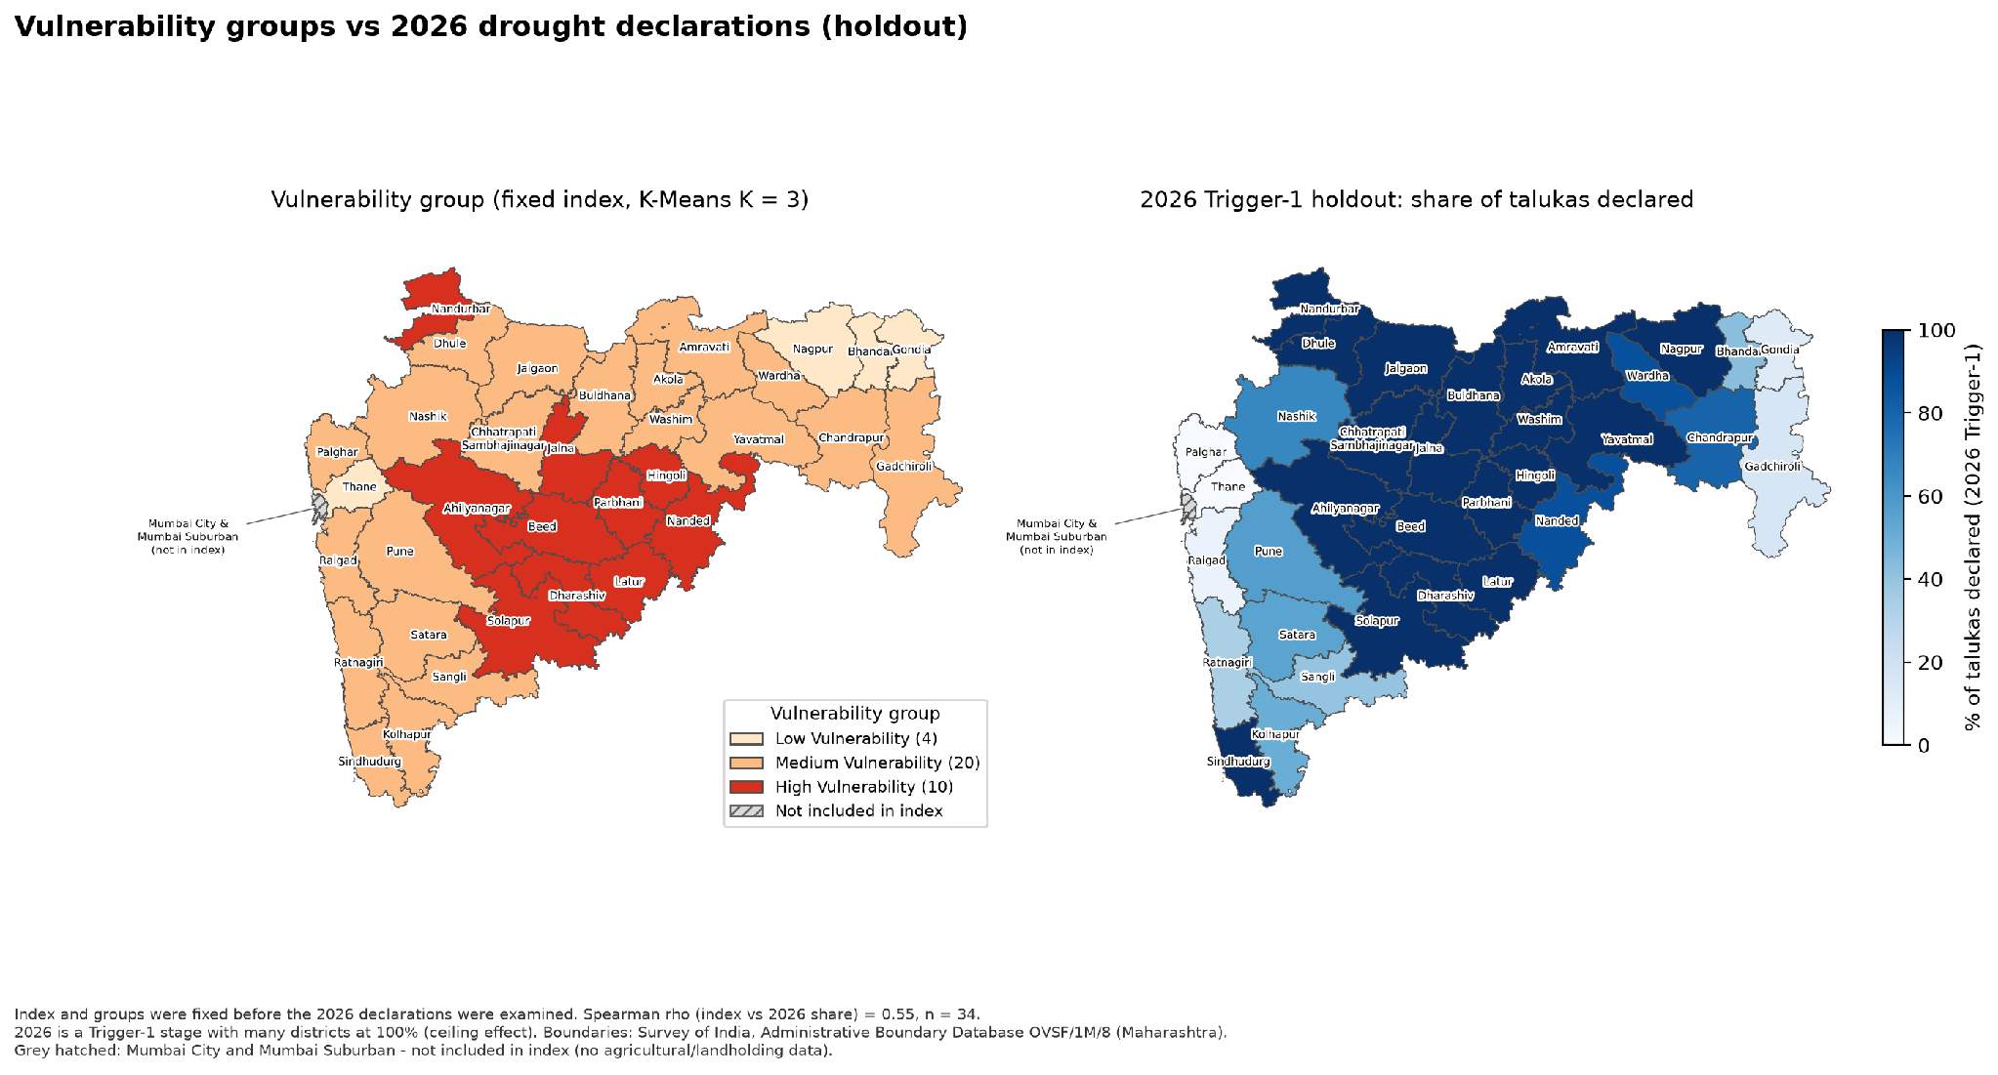
Validation: 2026 Holdout
Fig. 7: Vulnerability Groups vs 2026 Trigger-1 Declarations (Spearman ρ = 0.545)
29/9/2026

Slide 22
Robustness & Sensitivity Analysis
Comparison Version | Spearman ρ with Final Index | Largest Rank Change | Districts Changing Group
Equal weights (1/6 each) | 0.993 | 5 | 2
PCA absolute-loading weights, all 6 components | 0.995 | 3 | 1
Pune flagged rainfall years excluded | 0.995 | 3 | 1
Hazard + social sub-indices (50/50) | 0.991 | 6 | 1
ONI v6 instead of RONI | 0.961 | 6 | 4
OECD/JRC factor weights | 0.934 | 10 | 2
K-Means silhouette for K = 2 / 3 / 4: 0.594 / 0.587 / 0.571; K-Means and a tertile split agree for 25 of 34 districts.
No district moves between Low and High under any alternative; changes occur only near group boundaries.
Table 8: Robustness of the Index and Classification
29/9/2026

Slide 23
Limitations
Small sample of 34 districts: PCA and correlations carry statistical uncertainty, and parallel analysis retains only one component.
Weak common-factor structure (KMO = 0.40): the PCA-derived weights are exploratory and close to equal.
Socio-economic data from Census 2011 and Agriculture Census 2010-11 may not reflect current conditions.
District averages mask taluka and village-level variation; suspect IMD rainfall values (e.g., Pune 2005) are retained as published.
Drought declarations are administrative outcomes, so validation indicates association and not causation.
29/9/2026

Slide 24
Future Scope
Extend the analysis to taluka level and to other states or all of India.
Update the indicators with newer census and agriculture census data as they are released.
Incorporate additional climate drivers such as the Indian Ocean Dipole and La Niña, along with groundwater and heat stress.
Validate against crop-yield losses and revenue-circle-level declarations, and update the index annually.
29/9/2026

Slide 25
Conclusion
A reproducible, data-driven El Niño drought vulnerability index was developed for 34 districts of Maharashtra using climatic, agricultural and socio-economic indicators.
PCA provided objective indicator weights, and K-Means grouped the districts into Low (4), Medium (20) and High (10) vulnerability.
High relative vulnerability is concentrated in Marathwada and adjoining dry districts, and is lowest in Nagpur, Thane, Gondia and Bhandara.
The index is robust to alternative choices and positively associated with drought declarations, including the 2026 holdout; it is a relative, exploratory index, not a drought forecast.
29/9/2026

Slide 26
References
[1] S. Sahoo et al., "A review of sustainable drought resilience strategies for India's diverse agroclimatic landscapes," Hydrology Research, 2026.
[2] G. Balaganesh et al., "Development of household vulnerability index to climate change induced drought: empirical evidence from rural farm households in Tamil Nadu, India," Environment, Development and Sustainability, 2025.
[3] S. P. Manisha et al., "The Maharashtra River Basin's Flood-Drought-Water Scarcity Nexus," Global NEST Journal, vol. 26, no. 5, 2024.
[4] S. Sahu et al., "Comprehensive Drought Vulnerability Assessment in Northwestern Odisha: A Fuzzy Logic and Analytical Hierarchy Process Integration Approach," Water, 2023.
[5] S. Singh et al., "The 2023–24 El Niño event and its possible global consequences on food security with emphasis on India," Food Security, 2023.
[6] G. C. Paul et al., "Proposing an ensemble machine learning based drought vulnerability index using M5P, dagging, random sub-space and rotation forest models," Stochastic Environmental Research and Risk Assessment, 2023.
[7] A. Saha, "Vulnerability assessment of drought in India: Insights from meteorological, hydrological, agricultural and socio-economic perspectives," Gondwana Research, vol. 123, 2022.
[8] S. Nair and S. Mirajkar, "Drought vulnerability assessment across Vidarbha region, Maharashtra, India," Arabian Journal of Geosciences, 2022.
[9] R. S. Alharbi et al., "Assessment of drought vulnerability through an integrated approach using AHP and Geoinformatics in the Kangsabati River Basin," Journal of King Saud University - Science, vol. 34, 2022.
29/9/2026

Slide 27
References
[10] S. Saha, "Spatial assessment of drought vulnerability using fuzzy-analytical hierarchical process: a case study at the Indian state of Odisha," Geomatics, Natural Hazards and Risk, vol. 12, no. 1, 2021.
[11] J. E. Kim, J. S. Yu, J.-H. Ryu, J.-H. Lee and T.-W. Kim, "Assessment of regional drought vulnerability and risk using principal component analysis and a Gaussian mixture model," Natural Hazards, vol. 109, no. 1, pp. 707–724, 2021.
[12] C. E. Pinzón Flórez et al., "Designing a Territorial Composite Vulnerability Index to guide public health action in Cali, Colombia," PLOS One, vol. 21, 2026, doi: 10.1371/journal.pone.0332486.
[13] D. S. Pai et al., "Development of a new high spatial resolution (0.25° × 0.25°) long period (1901–2010) daily gridded rainfall data set over India," Mausam, vol. 65, no. 1, pp. 1–18, 2014.
[14] M. Nardo, M. Saisana, A. Saltelli, S. Tarantola et al., Handbook on Constructing Composite Indicators: Methodology and User Guide. OECD Publishing / European Commission JRC, 2008.
[15] IPCC, Climate Change 2001: Impacts, Adaptation and Vulnerability. Contribution of Working Group II to the Third Assessment Report. Cambridge University Press, 2001.
[16] NOAA Climate Prediction Center, "Oceanic Niño Index (ONI) and Relative Oceanic Niño Index (RONI)," 2026. [Online]. Available: https://www.cpc.ncep.noaa.gov
[17] Office of the Registrar General & Census Commissioner, India, "Census of India 2011: Primary Census Abstract and Village Directory, Maharashtra," 2011.
[18] Government of Maharashtra, "Agriculture Census 2010-11: Maharashtra State Report."
29/9/2026

Slide 28
Thankyou
29/9/2026

